Slide 1


Sarvajanik College of Engineering & Technology
Subject: Object Oriented Programming with Java
Topic: Applets and swing
Branch: Computer (Shift - 1)
Semester: 5
Prepared By: Darshit Akbari 160420107002
Amul Luniya 160420107003
Abhishek Chavda 160420107009
Tejas Khunt 160420107023
Keval Navadiya 160420107031

Slide 2
Introduction
Introduction to applets
Applet Life-cycle
Examples
Drawback of applets
Introduction to swing
GUI Component
Example
Layout Manager

Slide 3
Applet

Slide 4
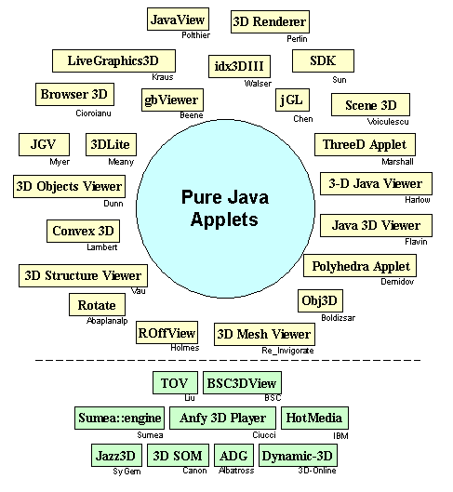

Slide 5
Introduction to Applets
Java applets are one of three kinds of Java programs:
An application is a standalone program that can be invoked from the command line.
An applet is a program that runs in the context of a browser session.
A servlet is a program that is invoked on demand on a server program and that runs in the context of a web server process

Slide 6
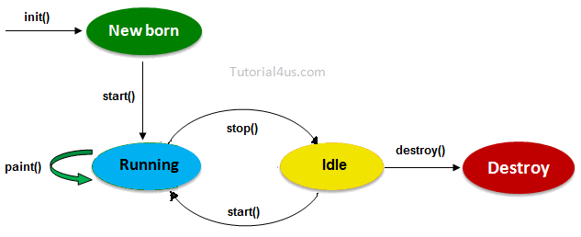
Applet Lifecycle

Slide 7
Applet Lifecycle
For creating any applet java.applet.Applet class must be inherited. It provides 4 life cycle methods of applet.
public void init(): is used to initialized the Applet. It is invoked only once.
public void start(): is invoked after the init() method or browser is maximized. It is used to start the Applet.
public void stop(): is used to stop the Applet. It is invoked when Applet is stop or browser is minimized.
public void destroy(): is used to destroy the Applet. It is invoked only once.

Slide 8
Applet Lifecycle
An applet program is a written as a subclass of the java.Applet class or the javax.swing.Japplet class. There is no main method: you must override the start method. Applet objects uses AWT for graphics. JApplet uses SWING.
It is a Graphics object that runs in a Thread object, so every applet can perform graphics, and runs in parallel to the browser process.
When the applet is loaded, these methods are automatically invoked in order:
the init( ) method is invoked by the Java Virtual Machine
The start( ) method
The paint( ) method.

Slide 9
Applet Lifecycle
The applet is run and rendered on the web page.
You program the start( ) method and the paint( ) method for your application, and invoke a repaint call to re-render the graphics, if necessary
At the end of the execution, the stop( ) method is invoked, followed by the destroy( ) method to deallocate the applet’s resources.

Slide 10
Example
//java File for applet
import java.applet.*;
import java.awt.*;
public class Main extends Applet {
public void paint(Graphics g) {
g.drawString("Welcome in Java Applet.",40,20);
}
}

Slide 11
Example
//Embed java class to html file
<HTML>
<HEAD>
</HEAD>
<BODY>
<div >
<APPLET CODE = "Main.class" WIDTH = "800" HEIGHT = "500"></APPLET>
</div>
</BODY>
</HTML>

Slide 12
Drawback
For security reasons, applets that are loaded over the network have several restrictions.
an applet cannot ordinarily read or write files on the computer that it's executing on.
an applet cannot make network connections except to the host that it came from

Slide 13
Swing

Slide 14
AWT to Swing
AWT: Abstract Windowing Toolkit
import java.awt.*
Swing:
import javax.swing.*
Extends AWT
Standard dialog boxes, tooltips, …
Look-and-feel, skins
Event listeners
API:
http://java.sun.com/j2se/1.3/docs/api/index.html

Slide 15
GUI Component
Java: GUI component = class
Properties
Methods
Events
JButton

Slide 16
Using a GUI Component
Create it
Instantiate object: b = new JButton(“press me”);
Configure it
Properties: b.text = “press me”; [avoided in java]
Methods: b.setText(“press me”);
Add it
panel.add(b);
Listen to it
Events: Listeners
JButton

Slide 17
Anatomy of an Application GUI
GUI
Internal structure
JFrame
JPanel
JButton
containers
JPanel
JLabel
JButton
JLabel

Slide 18
Using a GUI Component
Create it
Configure it
Add children (if container)
Add to parent (if not JFrame)
Listen to it
order important

Slide 19
Example
import javax.swing.*;
class hello {
public static void main(String[] args){
JFrame f = new JFrame(“title”);
JPanel p = new JPanel();
JButton b = new JButton(“press me”);
p.add(b); // add button to panel
f.setContentPane(p); // add panel to frame
f.show();
}
}
press me

Slide 20
Layout Manager Heuristics
null
FlowLayout
GridLayout
none, programmer sets x, y, w, h
Left to right,
Top to bottom
BorderLayout
CardLayout
GridBagLayout
n
c
One at a time
w
e
JButton
s

Slide 21
Example
JFrame
JButton
JButton
n
JPanel: BorderLayout
c
JPanel: FlowLayout
JTextArea

Slide 22
Thank You

